Slide 1
The Collaborative Platform for CanESM (CP4C): Project Overview
Paul Kushner¹, Neil Swart², Jack Wong¹, Haruki Hirasawa^{1,3}, Clint Seinen², Daniela Bodden¹
¹University of Toronto, ²ECCC/CCCma , ³University of Victoria
Thanks to:
$$→$$

Slide 2
The Collaborative Platform for CanESM (CP4C): Project Overview
Background: Developments starting from ARRCU March 2021

Slide 3
ARRCU Workshop: Application, Analysis and Collaborative Development with Canada’s Earth System Model (CanESM)
Paul Kushner (U Toronto, ARRCU chair, organizing committee chair) thanks the teams:
Organizing committee: Neil Swart (ECCC), Ellie Farahani (ECCC), Nathan Gillett (ECCC), Shawn Marshall (U Calgary/ECCC), Julie Thériault (UQAM), Kirsten Zickfeld (SFU)
Panelists: Joe Melton (ECCC), Paul Myers (U. Alberta), Hansi Singh (U Victoria), Julie T, Kaley Walker (U Toronto), Kirsten Z
ARRCU executive + advisory board: Adam Monahan (U Vic, vice chair), Pierre Gauthier (UQAM, secretary/treasurer), Hind Al-Abadleh (Wilfred Laurier U), Yanping Li (U. Sask), Paul M, Roland Stull (UBC), Neil Tandon (York), Bruno Tremblay (McGill), Aldona Wiacek (St. Mary’s U)
From March 11, 2021
Agenda:
Time Topic
2:30-2:40 Introduction, workshop goals (Paul K)
2:40-3:10 The CCCma strategic plan and building a collaborative CanESM (Neil S)
3:10-3:30 Results of ARRCU community survey (Paul K)
3:30-3:45 Break
3:45-5:00 Panel discussion - use cases, broader context. 5:00-5:30 Break, followed by open discussion, next steps.
This meeting is being recorded

Slide 4
ARRCU Workshop: Application, Analysis and Collaborative Development with Canada’s Earth System Model (CanESM)
Paul Kushner (U Toronto, ARRCU chair, organizing committee chair) thanks the teams:
Organizing committee: Neil Swart (ECCC), Ellie Farahani (ECCC), Nathan Gillett (ECCC), Shawn Marshall (U Calgary/ECCC), Julie Thériault (UQAM), Kirsten Zickfeld (SFU)
Panelists: Joe Melton (ECCC), Paul Myers (U. Alberta), Hansi Singh (U Victoria), Julie T, Kaley Walker (U Toronto), Kirsten Z
ARRCU executive + advisory board: Adam Monahan (U Vic, vice chair), Pierre Gauthier (UQAM, secretary/treasurer), Hind Al-Abadleh (Wilfred Laurier U), Yanping Li (U. Sask), Paul M, Roland Stull (UBC), Neil Tandon (York), Bruno Tremblay (McGill), Aldona Wiacek (St. Mary’s U)
Agenda:
Time Topic
2:30-2:40 Introduction, workshop goals (Paul K)
2:40-3:10 The CCCma strategic plan and building a collaborative CanESM (Neil S)
3:10-3:30 Results of ARRCU community survey (Paul K)
3:30-3:45 Break
3:45-5:00 Panel discussion - use cases, broader context. 5:00-5:30 Break, followed by open discussion, next steps.
This meeting is being recorded

Slide 5
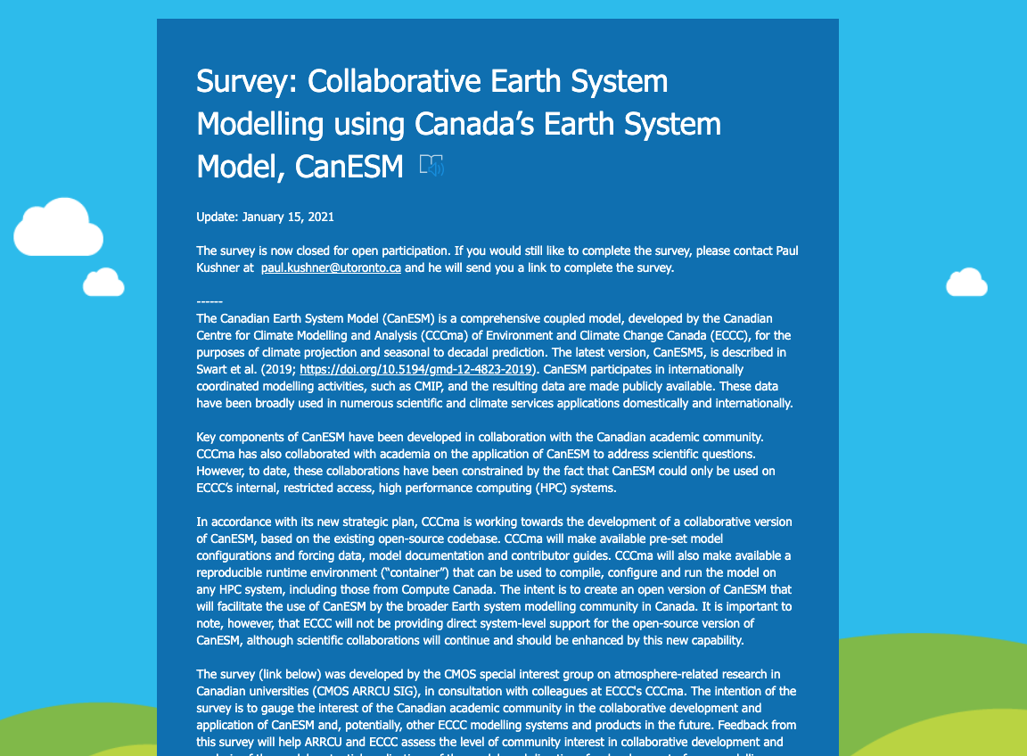
Community survey snapshot
Healthy interest, from a scientifically diverse community, with reasonable expectations for the Collaborative CanESM
30 faculty = 100+ users now and many more users down the road.
Workshop conclusions:
Collaborative CanESM = mechanism to enhance scientific collaboration with ECCC.
Academic community seeks long-term commitment to Collaborative CanESM, good documentation, rather than direct technical support.
Also desire enhanced access to other ECCC models (CanRCM/GEM family of models).
This community sees the enhanced collaborative versions of models from ECCC as tools of research partnership and collaboration, for a wide variety of applications.
Enhancing such collaboration is also in ECCC’s interest.
From March 11, 2021

Slide 6
Developments since March 2021
Spring/summer 2021:
Call to ARRCU community for expressions of interest to contribute to Compute Canada Research Portals and Platforms (RPP) proposal.
From the group that responded to this RPP solicitation, further solicited interest in submitting NSERC Alliance Mission proposal in partnership with ECCC

Slide 7
Developments since March 2021
Proposals submitted fall 2021:
Compute Canada RPP proposal (Kushner PI) – successful – compute and cloud resources
Compute Canada RRG fast track renewal (Swart PI) – successful – compute resources
ECCC G&C with CCCma until March 2022 (Kushner PI) – successful – initial CP4C work
NSERC Alliance Mission proposal (Kushner PI) – not successful

Slide 8
Developments since March 2021
November 2021 - March 2022:
Working group began work on CP4C using ECCC G&C funding
Planning for this workshop
Submitted expression of interest in renewal of ECCC G&C.

Slide 9
The Collaborative Platform for CanESM (CP4C): Project Overview
What is the CP4C?

Slide 10
What is the CP4C?
A research platform to increase Canada’s capacity in development, application, and analysis of Earth System Models (ESMs) using Canada’s Earth System Model, CanESM
Intended to lower barriers to collaboration with ECCC and act on its interest in collaborative development of CanESM
Technical workflow to port, run, record/document, analyze CanESM simulations
Development to bring new capabilities to CanESM from collaborative community.
Scientific research examples: templates for work in a collaborative-development and application framework.
Modest compute resources required to test, carry out limited production simulations, and systematically document such runs.

Slide 11
Initial goals of the CP4C project (3 year period) Accomplished, In Progress, Planned
Goal | Tasks/Status
Development and implementation of CP4C | CanESM5 bare-metal port and performance optimization CanESM production and analysis workflow with IMSI Core ESM production simulations (CMIP DECK) Test first ESM workflow Refine ESM production runs and analysis workflow
Use and development of CanESM | CP4C team training Community training Community feedback Collaborative R&D with CP4C: Technical Collaborative R&D with CP4C: Scientific

Slide 12
Initial goals of the CP4C project (3 year period) Status: Accomplished, In Progress, Planned
Goal | Tasks/Status
Development and implementation of CP4C | CanESM5 bare-metal port and performance optimization (Jack Wong) CanESM production and analysis workflow with IMSI (Jack Wong) Core ESM production simulations (CMIP DECK) Test first ESM workflow Refine ESM production runs and analysis workflow
Use and development of CanESM | CP4C team training Community training Community feedback Collaborative R&D with CP4C: Technical (Haruki Hirasawa) Collaborative R&D with CP4C: Scientific (Friday panels)

Slide 13
Resources
Initial seed funding from ECCC: work will continue into summer.
Hope to hear soon about G&C renewal.
Current regular CP4C team: co-authors of this talk plus a couple of others.
Please contact us if you wish to join.
A working and optimized version of CanESM exists on SciNet Niagara (Jack Wong).
Output is of limited scientific utility at the moment (level fields)
Port with more useful diagnostic output and production capability to do CMIP DECK runs should be ready by end of summer.
Once ready, we tentatively plan to hold a tutorial on CP4C, August 2022.

Slide 14
Resources
Allocations on Alliance/Compute Canada:
RRG allocation (about 100 core years, one more fast track renewal), Cedar
RPP allocation (about 100 core years plus reasonable storage and cloud resources, for three years), Niagara and Arbutus
Initial tutorial materials and CanESM documentation in prep.
Please note that all co-PIs (Fletcher, Li, Tan, Zickfeld) are currently sharing the RPP account! Tags are pjk-rpp, pjk-cpp

Slide 15
Conclusions
We want to build a collaborative community using this new infrastructure.
Please suggest ideas and directions during the workshop
Subsequent talks will feature a mix of recent work and development for CanESM and the initial work of CP4C.

