Slide 1
Analysis for Development (A4D) & CCCma published data
Michael Sigmond & James Anstey (CCCma)
Vivek Arora, Jason Cole, Nathan Gillett, Slava Kharin, Bill Merryfield, Cathy Reader, John Scinocca, Andrew Shao, Neil Swart, Jack Virgin, Libo Wang, and others..
CP4C workshop, 21 April 2022

Slide 2
What is A4D?
At the Dec 2019 CCCma strategic meeting a need was identified for increased and more coordinated model analysis to support the ongoing development of CanESM
Early 2020 the CRD wide A4D activity established
A4D Goal: establish a comprehensive process through which CanESM output is analysed in a systematic and ongoing manner, with the goal of improving future model versions

Slide 3
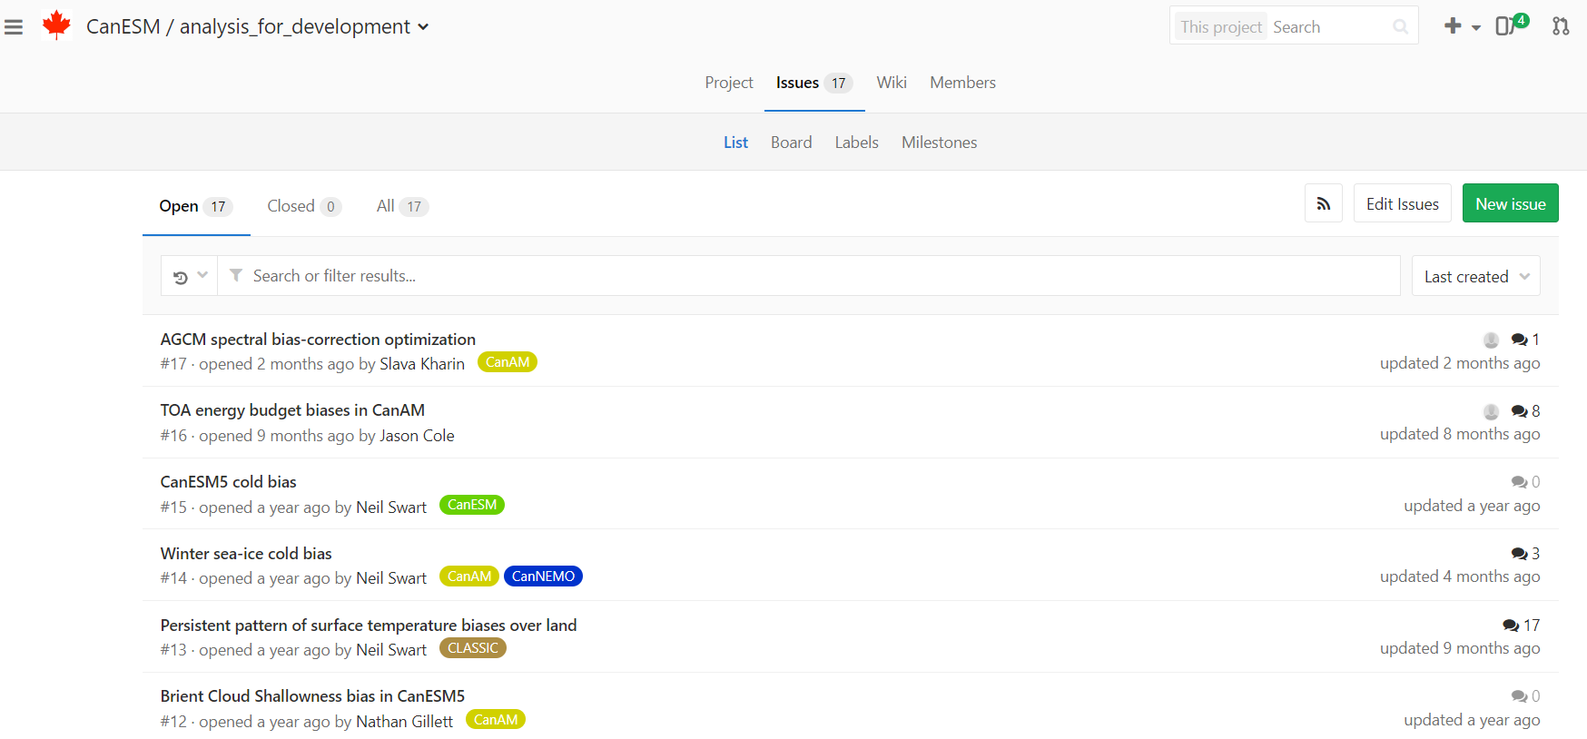
A4D process
Collect and document systematic model biases in an online archive (gitlab issue tracker)
Established working groups (WG) with WG leaders
Discuss on these issues during monthly A4D meetings
Report results in either:
- ‘Deep-dive’ paper (GMD special issue)
- Group CanESM5 analysis paper

Slide 4
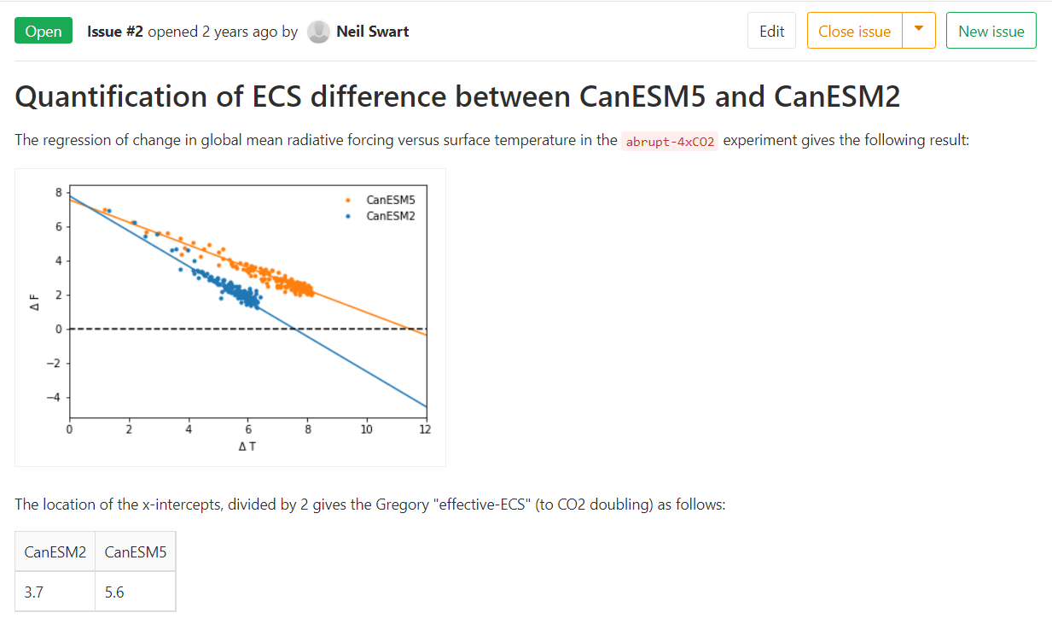
A4D process
Collect and document systematic model biases in an online archive (gitlab issue tracker)
Established working groups (WG) with WG leaders
Discuss on these issues during monthly A4D meet
Report results in either:
- ‘Deep-dive’ paper (GMD special issue)
- Group CanESM5 analysis paper

Slide 5
A4D process
Collect and document systematic model biases in an online archive (gitlab issue tracker)
Established working groups with WG leaders
Discuss on these issues during monthly A4D meetings
Report results in either:
- ‘Deep-dive’ papers (GMD special issue)
- Group CanESM5 analysis paper

Slide 6
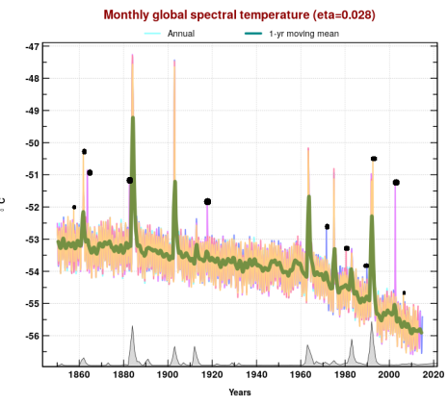
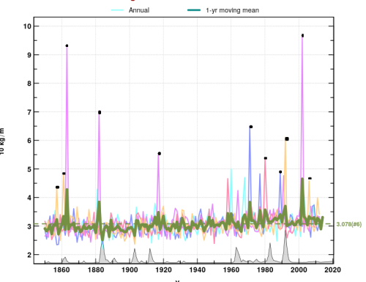
Spurious stratospheric warmings
Lower stratospheric temperature
The issue:
CanESM5.0 features large spurious/non physical stratospheric warmings (mainly in summer)
Cause:
Spurious spikes in coarse mineral dust, which were caused by unphysical mass-fixer corrections
mineral dust mass
Slava Kharin et al
Notes:
- mass corrections are implemented in the model to ensure that the mass of the advective hybrid tracers is conserved,
the default hybridization parameters caused these mass corrections to be of large positive values for dust tracers,
which triggered some sort of positive feedback resulting in artificial dust bursts propagating into the lower stratosphere,

Slide 7
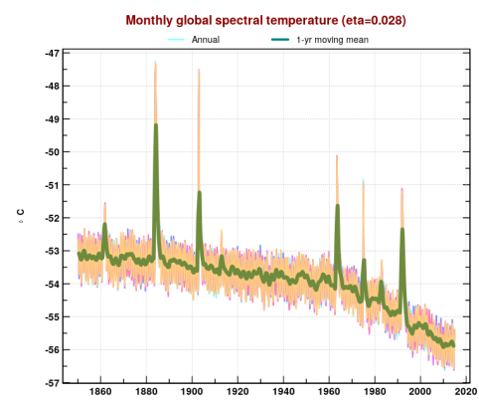
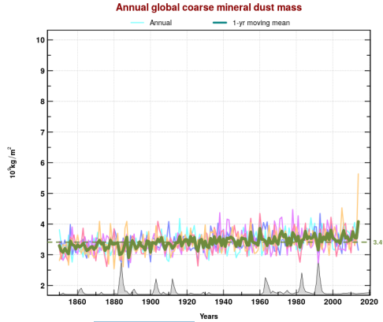
Spurious stratospheric warmings
Lower stratospheric temperature
The issue:
CanESM5.0 features large spurious/non physical stratospheric warmings (mainly in summer)
Cause:
Spurious spikes in coarse mineral dust, which were caused by unphysical mass-fixer corrections
mineral dust mass
Solution:
Retuned dust tracer hybridization parameters (implemented in CanESM5.1)
Slava Kharin et al
Notes:
- mass corrections are implemented in the model to ensure that the mass of the advective hybrid tracers is conserved,
the default hybridization parameters caused these mass corrections to be of large positive values for dust tracers,
which triggered some sort of positive feedback resulting in artificial dust bursts propagating into the lower stratosphere,

Slide 8
ENSO
The issue:
ENSO in CanESM5 is too weak and has incorrect seasonality
→ CanESM5 ENSO seasonal prediction skill is lower than CanCM4
Possible causal factor:
Analyses of CMIP6 models suggest biases in ENSO seasonality arise from biases in the equatorial Pacific SST/zonal wind mean seasonal cycle
Possible solutions:
Systematic tuning
9 CanAM5 parameters systematically varied
4 “Goodness” metrics include Nino3.4 σ →
Runtime bias correction
Save nudging tendencies from assimilation run, and apply these as tendency correction in free run
→ ocean biases reduced, ENSO strength & seasonality improved, experimentation ongoing
Bill Merryfield, Slava Kharin, Woosung Lee, John Scinocca

Slide 9
Climate sensitivity
The issue:
CanESM5 has highest ECS of all CMIP6 models (5.6 K), and much higher than CanESM2 (3.7 K)
New analysis (Virgin et al 2021):
ECS increase in CanESM5 relative to CanESM2 due to more positive shortwave cloud feedbacks
Spatial pattern of surface temperature change impacts magnitude and distribution of low-cloud response
Objective CanESM5 tuning
Led to lower ECS (4.6 K) in CanESM5.1 p2 version
Shortwave boundary layer cloud feedbacks are weaker than CanESM5.0 (shallow convection)
Jack Virgin, Jason Cole

Slide 10
Some results from other WGs
Atmospheric circulation: too few sudden stratospheric warmings
Too many in CanESM2; difference due to orographic gravity wave drag (OGWD)
Retuned OGWD to get rid of SSW bias
Cold bias over Himalayas, related to high albedo bias
new snow parameterization
investigate impact of precipitation bias
Too much sea ice in North Atlantic
Hypothesis: atmospheric circulation bias
Winter cold bias over sea ice
Possibly too small conductivity
Mismatch between TOA balance in AMIP runs (2.5 W/m²) vs coupled run/observations (1.0 W/m²)
Due to spatial patterns of SST

Slide 11
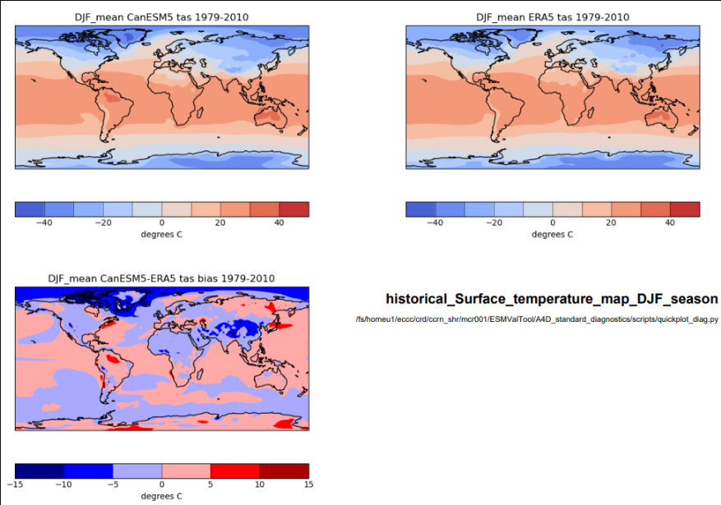
A4D standardized diagnostic package
To address the need to track model biases from one model version to the next in a systematic manner
Based on ESMValtool (python community tool)
No ESMValtool/python knowledge required to use package and enter new (simple) diagnostics
Cathy Reader, James Anstey, Michael Sigmond, Cynthia Whaley

Slide 12
A4D Conclusions
A4D activity encourages and coordinates analysis in support of model development
Some progress has been made, but we are constrained by limited HR
Call for collaborations!
Please contact us if you like to contribute to a WG, start one, or participate in A4D meetings
Michael.Sigmond@ec.gc.ca James.Anstey@ec.gc.ca

Slide 13
Now over to James…

Slide 14
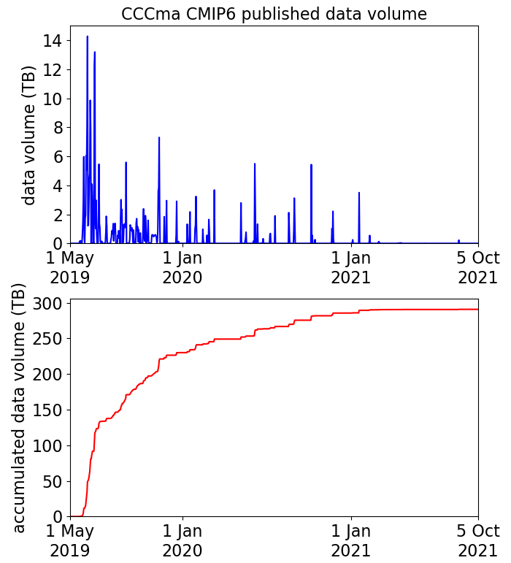
CanESM5 CMIP6 output published on ESGF
CCCma (ECCC) currently hosts 300 TB of data on the ESGF network
~ 1 PB of CanESM5 model output has been downloaded from the ECCC ESGF server, as well as ~300 TB from other ESGF nodes
ESGF downloads (TB)

Slide 15
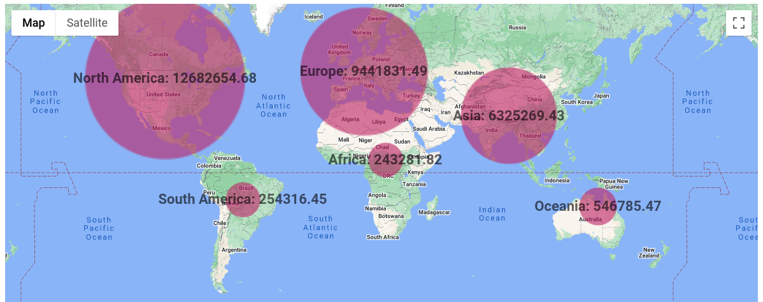
Worldwide CMIP6 downloads, by region
12.7 PB
9.4 PB
6.3 PB
0.24 PB
0.25 PB
0.55 PB
http://esgf-ui.cmcc.it/esgf-dashboard-ui/geo-downloads.html
Worldwide total: ~ 30 PB, of which CanESM5 represents ~1.3 PB
(note CanESM5 is relatively lower resolution than many models, hence lower volume per dataset)

Slide 16
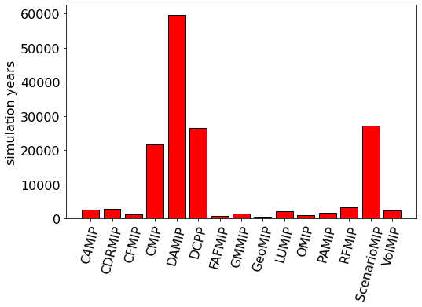
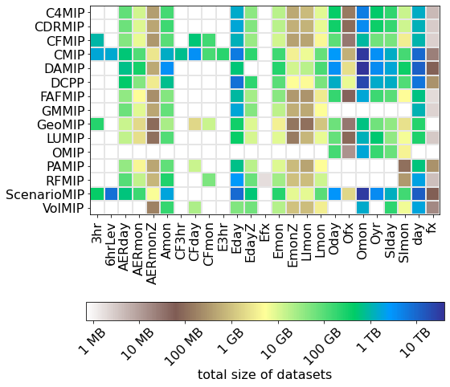
Simulation years published, by MIP
(total ~154,000 years)
Published data volume,
by MIP and CMOR table (total ~300 TB)

Slide 17
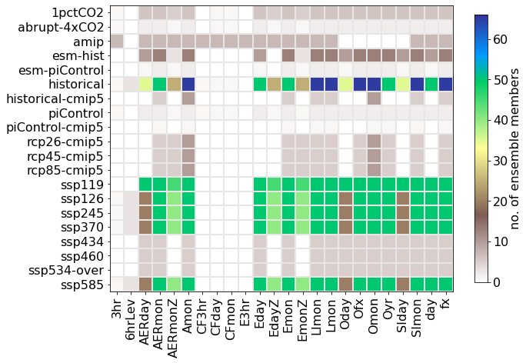
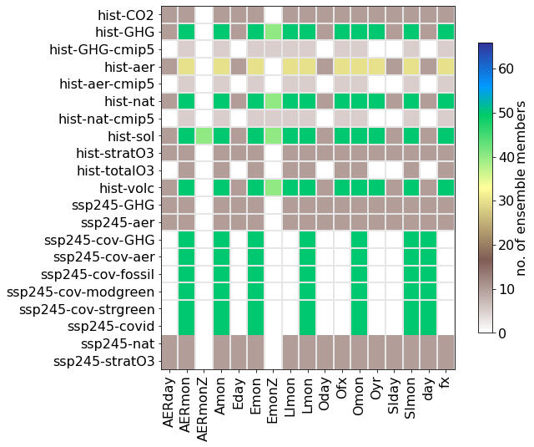
Large ensembles
historical & SSP experiments
DAMIP experiments

Slide 18
Summary
CanESM5 CMIP6 output is fairly large and covers the experiments and data requests from most of the CMIP6 Endorsed MIPs.
The wide range of published output variables allows for extensive evaluation of many aspects of the model.
Not all output variables from the model are published on ESGF. Additional variables might be available on request.
A large ensemble of historical & SSP runs is available
Output of CMOR-ized netcdf files following CMIP6 conventions is now a standard feature of CanESM.
This facilitates routine comparison of new CanESM versions with the CMIP6 version of CanESM5 and other CMIP6 models.

Slide 19
Extra slides

Slide 20
A4D working groups/model biases
Climate sensitivity: (Jason Cole, Jack Virgin)
ENSO (Bill Merryfield et al)
North Atlantic (Andrew Shao et al)
Cold drift in coupled PI runs (John Scinocca et al)
Sea ice thermodynamics (Neil Swart et al)
TOA fluxes (Jason Cole et al)
E Asia dust bias (Knut von Salzen et al)
Stratospheric warming spikes (Slava Kharing et al)
Brient Cloud Shallowness (Jason Cole, Nathan Gillett)
Atmospheric circulation biases (Michael Sigmond, James Anstey)
Ocean energy budget (Oleg Saenko)
Snow biases, cold land bias (Vivek Arora, Jason Cole et al)
Systematic tuning (Slava Kharin, John Scinocca)

Slide 21
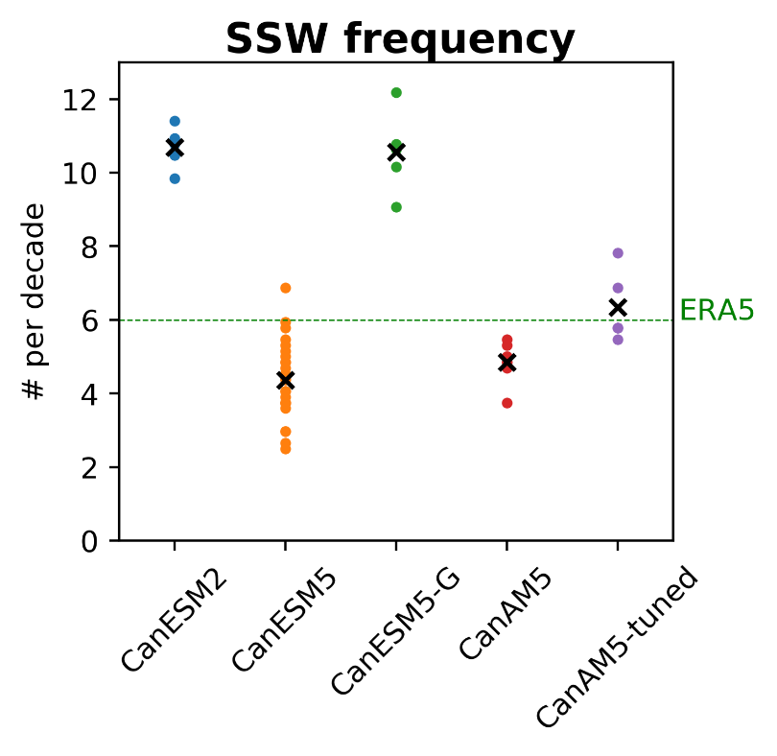
Atmospheric circulation
The issue:
SSW warming frequency too high in CanESM5 (too low in CanESM2)
→ May impact seasonal forecasts
Cause:
CanESM2 vs CanESM5 difference due to difference in OGWD settings
Solution:
Found OGWD settings that result in good SSW statistics
Caveat:
Not all atmospheric circulation biases (lower stratospheric winds) reduced with new tuning settings
Michael Sigmond, James Anstey

