Slide 1
CanESM5 Ensemble Consistency Testing
Haruki Hirasawa¹, Paul Kushner¹,
Neil Swart²
¹University of Toronto
²Environment and Climate Change Canada

Slide 2
Verification of Earth System Model code changes and ports
ESMs are complex and chaotic, meaning code, compiler, and processor changes can easily influence the output of the models.
If we make a change, such as porting a model, how do we ensure the ESM port performs as expected?

Slide 3
How do we verify ESMs?
Bit for Bit reproduction: Cheap, effective, but too stringent for most applications
Single Long test simulation: Standard, but costly
Ensemble consistency test: Cheaper, but potentially higher false-positive rate

Slide 4
Bit for Bit (BFB) Reproduction Testing
Directly compare test output to reference, bit for bit
Small changes can break BFB reproduction
Porting ESMs to new machines will practically always break BFB reproduction.

Slide 5
Long-Term climate comparison
Compare climate mean and variability across variables to ensure there is no significant change in ESM climate.
Computationally expensive (>100 year simulations)

Slide 6
Ensemble Consistency Testing
An alternative method developed for the Community Earth System Model (Baker at al., 2015)
Test small ensemble of short simulations (as few as 9-time steps – Milroy et al., 2018) against a large ensemble of reference data
Cheap, but relatively high false positive (false fail) rate

Slide 7
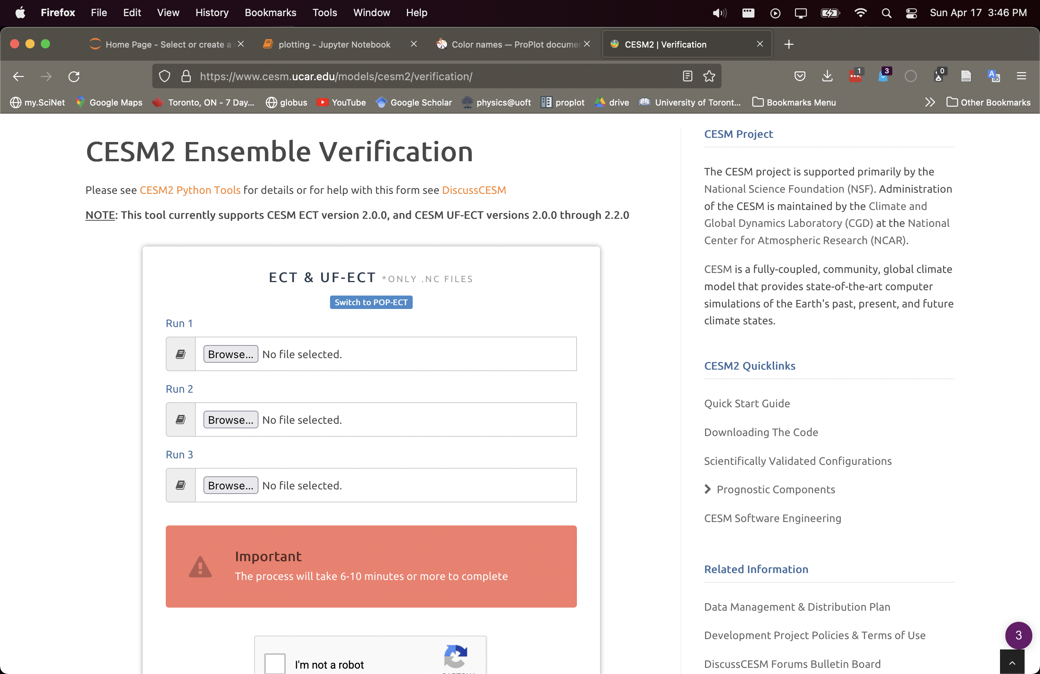
pyECT
In CESM2, a standard set of scripts are used to run and average a 3-member ensemble
Upload to UCAR website to get the results of the test
We slightly modify pyCECT and can apply it to containerized CanESM5

Slide 8
ECT outline
Generate a reference ensemble of 1-year simulations
1
Generate the reference ensemble summary file
2
Run a test ensemble: small 3-member ensemble of 1-year simulations
3
Perform the ECT on the test ensemble.
4

Slide 9
Generating the Ensemble Summary File
1
Generate an N_{ens}-member ensemble of 1-year simulations where N_{ens} > N_{var}
2
Calculate global, annual average for all N_{var} variables.
3
Standardize by removing ensemble mean and dividing by standard deviation
Apply Principal component analysis across the ensemble to capture relationships between variables in the ensemble
4

Slide 10
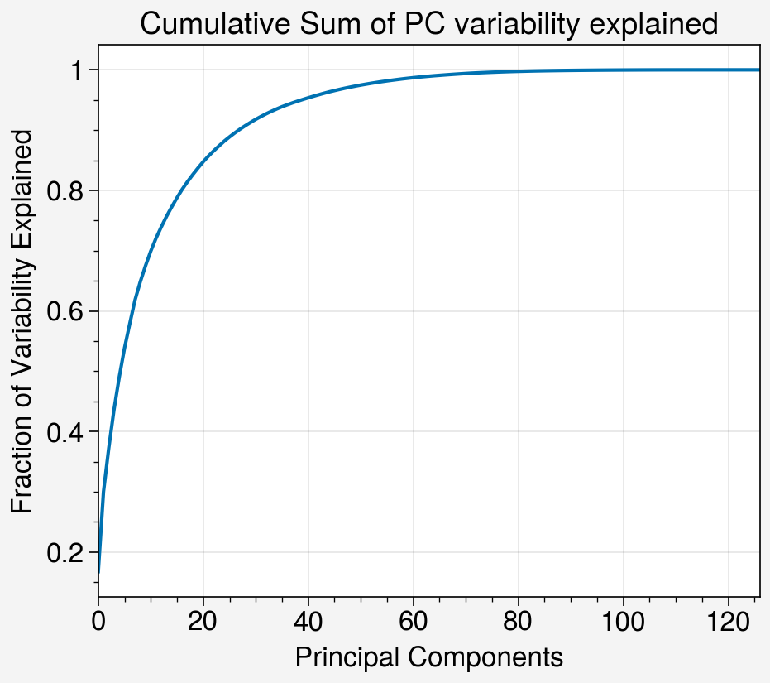
WestGrid-Cedar Reference Ensemble
Use an early containerized version of the CanESM5 port (thus only uses 2D variables)
Reference ensemble generated on WestGrid’s Cedar machine
Cedar was previously verified using a long climatological simulation
N_{ens}=250
N_{var}=127

Slide 11
Testing a new code change or port
$\text{Run} \text{a} \text{smaller} \text{ensemble} \text{of} N_{test}=3 \text{simulations}\text{. }$
Calculate global and annual mean and standardize data from test ensemble
Calculate scores using loadings from the reference ensemble

Slide 12
ECT Criteria
For each PC up to $N_{PC}$:
For each run:
If the PC score for the run falls outside the $m_{σ}$ the run fails
If ${≥N}_{runFail}$ runs fail, the PC fails
If $≥N_{pcFail}$ PCs fail, the test overall fails
pyCECT uses:
${N_{PC}=50, m}_{σ}=2 , N_{test}=3,{ N}_{runFail}=2, N_{pcFail}=3$

Slide 13
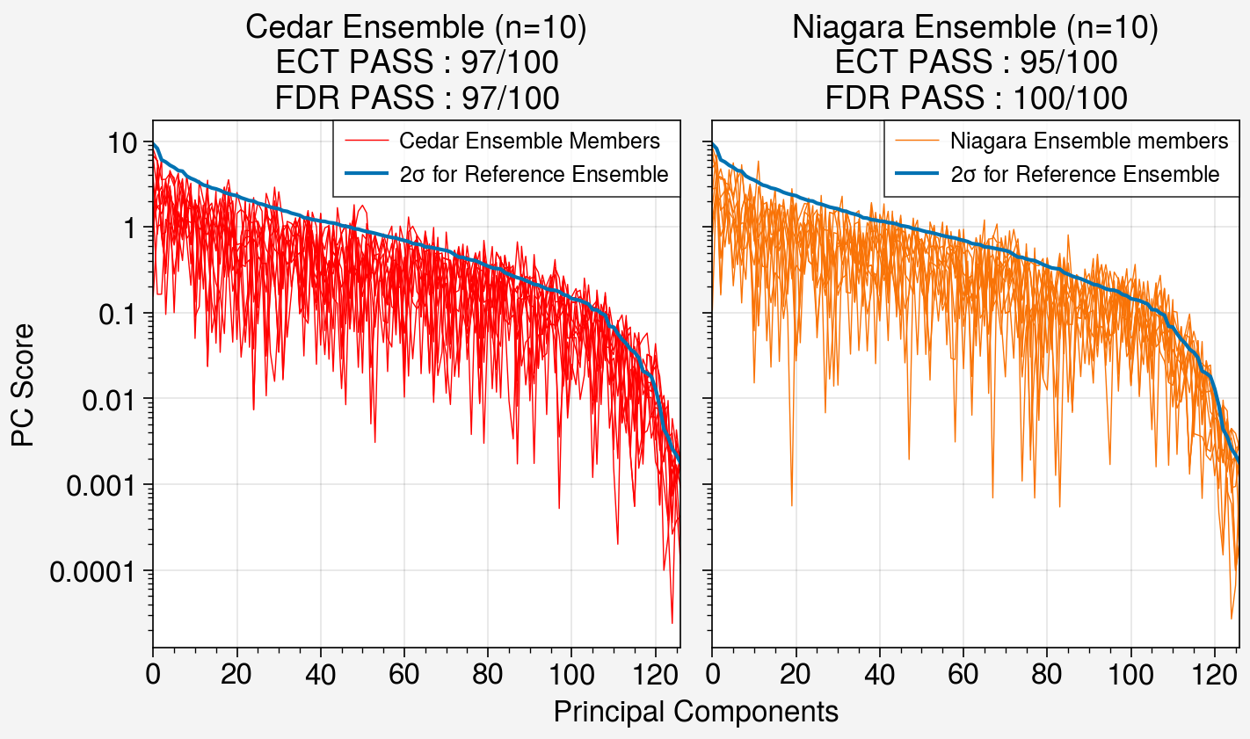
ECT Pass rate
Randomly resample 3 members from 10 member ensembles and run ECT
ECT produces a false positive rate of ~5% for Cedar CanESM5 data.
Likely due to non-Gaussian distribution of higher order PCs.
Similar performance between Niagara and Cedar, indicating Niagara port passes the ECT!

Slide 14
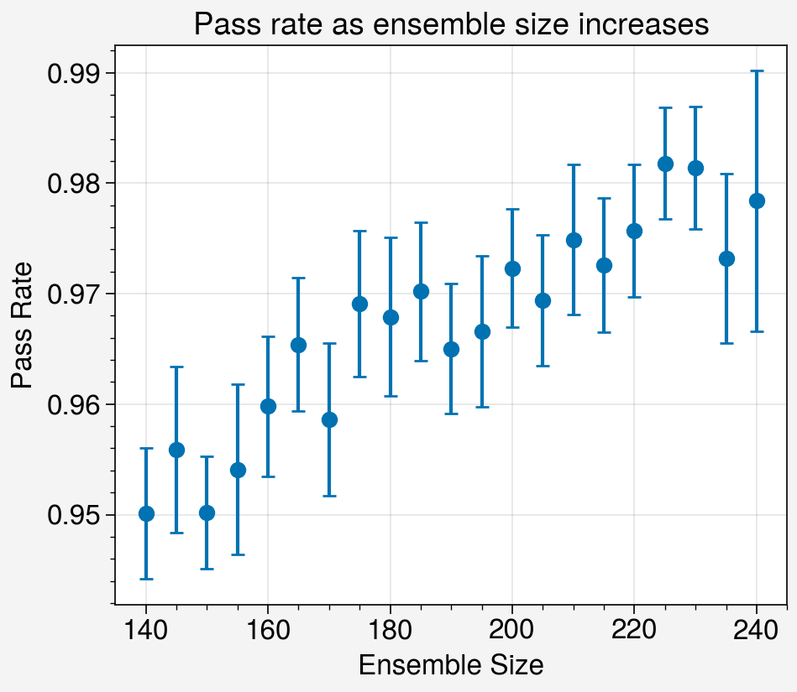
How do we reduce the false-positive rate?
Increasing the reference ensemble size reduces the false-fail rate (up to ~2%)
Diminishing returns, indicating we need a very large ensemble size to achieve the target ~0.5% false positive rate.

Slide 15
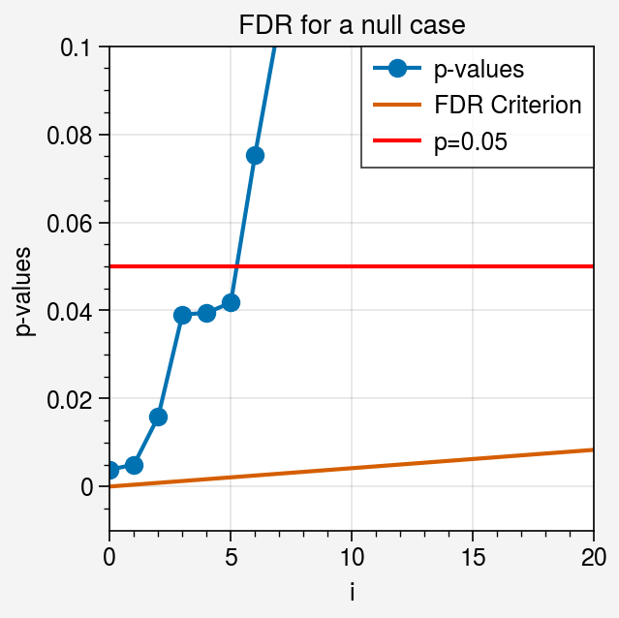
False Discovery Rate
A type of multiple significance test based on the expected rate of false rejections of a null hypothesis (Benjamini and Hochberg 1995; Wilks 2016)
Procedure:
Calculate the t-test p-value for each PC
Sort p-values in ascending order ($p_{(i)})$with $\left(i\right)$indexing the ascending values
Calculate $p_{FDR}=\max_{i=1,…,N}{[p_{\left(i\right)}:p_{\left(i\right)}≤\left(\frac{i}{N}\right)α_{FDR}]}$
For data set size $N$ and rate of false rejections $α_{FDR}$

Slide 16
FDR Pass Rate
Randomly resample 3 members from 10 member ensembles and run FDR
FDR criteria results in a similar or lower false fail rate
Thus, FDR appears to be more lenient.

Slide 17
What does the ECT look like when it is meant to fail?
We test the effect of increasing solar constant
We see many PCs now exceed the $2σ$ level, and the test thus fails

Slide 18
How large of a climate change is necessary for the ECT to fail?
Test increasing solar constant up to 1.25Wm⁻²
A large (~1Wm⁻²) perturbation is required before the ECT reliably fails
FDR is more sensitive and reliably fails at lower perturbations

Slide 19
Conclusions
CanESM5
The pyCECT developed for CESM can easily be modified to work with CanESM5 data
ECT has more false positives for CanESM5 than CESM1
ECT is relatively insensitive to model parameter changes up to 1Wm-2
Sensitivity is improved using FDR instead

Slide 20
Future Work
CanESM5
Run port verification for “bare-metal” CanESM5 port
Implement ECT/FDR using IMSI diagnostic output
Test a larger suite of parameter perturbations

